Slide 1


INSTRUMENT DEVELOPMENT STATUS
A.PENQUER . IASI-NG INSTRUMENT MANAGER
CENTRE NATIONAL D’ÉTUDES SPATIALES (TOULOUSE, FRANCE)

Slide 2
OVERVIEW
CHALLENGING SPECIFICATIONS
GEOMETRY | SOUNDER PIXEL SIZE | ~12 km
 | SPATIAL SAMPLING | ~25 km
 | GEOLOCATION ERROR | 0.5 km
SPECTRAL | BAND | 645 cm-1 to 2760 cm-1
 | RESOLUTION | 0,25 cm⁻¹
 | SAMPLING | 0,12 cm⁻¹
 | CALIBRATION ERROR | dσ/σ= 5.10⁻⁷
RADIOMETRY | CALIBRATION ERROR | 0,25K @ 280 K
 | NEDT | NedT ~0.1 K to 0.4 Kwithin spectrum
SAME AS
IASI
2 TIMES BETTER
THAN IASI

Slide 3
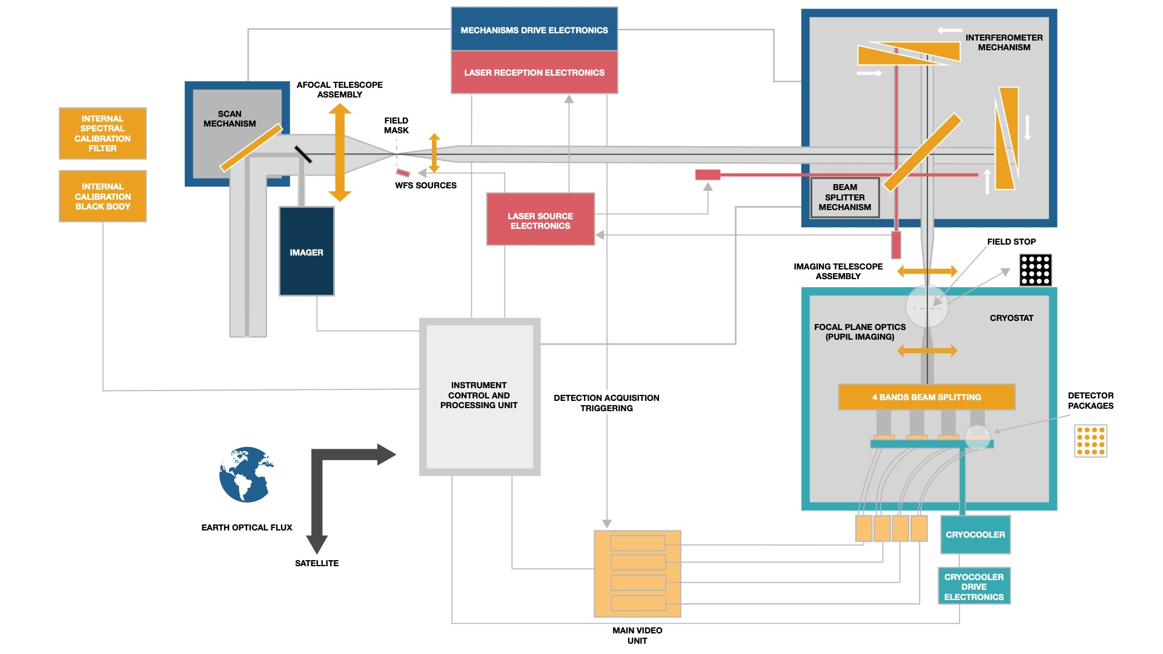
OVERALL
DESIGN
Performances met with 4 spectral bands thanks to a wider field of view (16 sounder pixels)
Associated field effects compensated in pupil through Mertz Interferometer (prisms with variable thickness over the swing)
Main drawback: sensitivity to pupil effects (tilt, MSE,…)
Pupill effects monitored and corrected through 4 lateral metrology lasers; central metrology gives the OPD-constant acquisition triggering
SWATH | ~ 2000 KM
FOR | +/- 3°
PUPIL DIAMETER | ~ 90 MM
ATA MAGNIFICATION | 2.3
MAXIMUM OPTICAL PATH DIFFERENCE | 4,2 CM
ACQUISITION DURATION | ~730 MS
SCAN LINE DURATION | 15.6 S: 14 EARTH VIEWS + 1BB + 1CS
CO-REGISTRATION | INTEGRATED IMAGER
SPECTRAL CALIBRATION | FABRY PEROT SOURCE

Slide 4
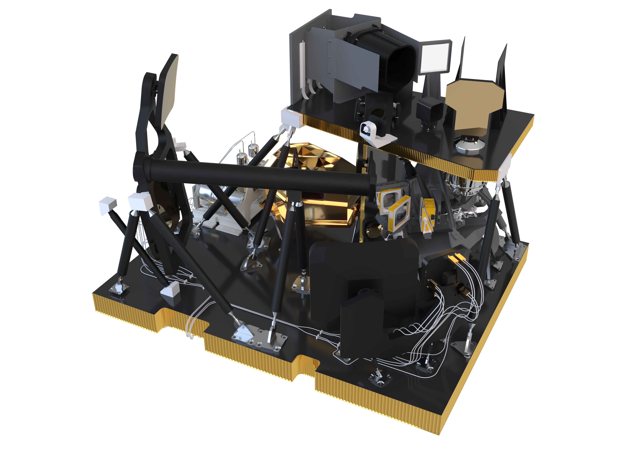
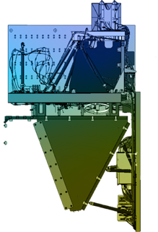

INSTRUMENT BUDGET
I-OH
(OPTICAL MODULE)
SAT I/F
I-EM
(ELECTRONICS MODULE)
MASS | 430 KG
POWER | ~520 W
I/F DATA RATE | ~6 MB/S

Slide 5


IFM EQM QUALIFICATION
Thermal qualification
Temperature gradient and slopes within required range wrt. KBr

Slide 6
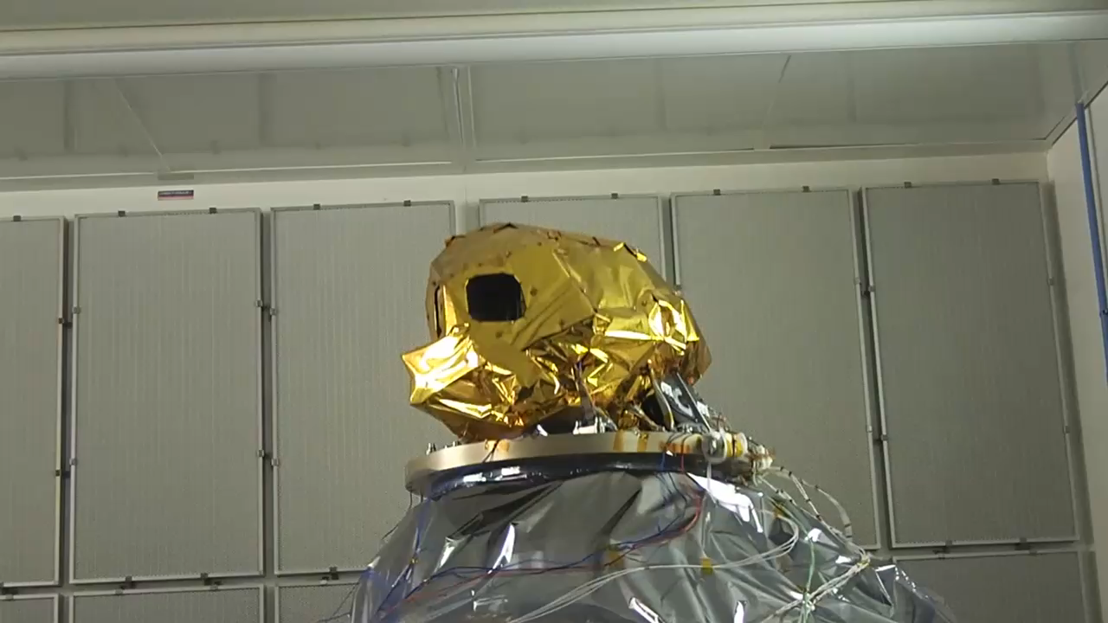
IFM EQM QUALIFICATION
Thermal qualification
Temperature gradient and slopes within required range wrt. KBr
Mechanical qualification
Small BS displacement compatible with actuator realignment capabilities

Slide 7
IFM EQM QUALIFICATION
Reference test after qualification
Very stable optical performances after qualification
Qualification successful
MEASUREMENT | REQUIREMENT | STATUS
ΔWFE | ABSOLUTE WAVEFRONT TILTS STABILITY | OK
 | ΔOPD STABILITY | OK
 | ΔWFE STABILITY | OK
IFG | ΔWFE IN POLARISATION STABILITY | OK
 | ZPD POSITION STABILITY | OK
 | STT NUMBER MARGIN & SPL FLAGS | OK
 | VOPD STABILITY | OK
 | ME STABILITY | OK
 | METROLOGY TILTS STABILITY | OK
 | BSMA SINUS MODE CHECK | OK
MECHANISM | RDYN0 | OK
 | STAB | OK

Slide 8

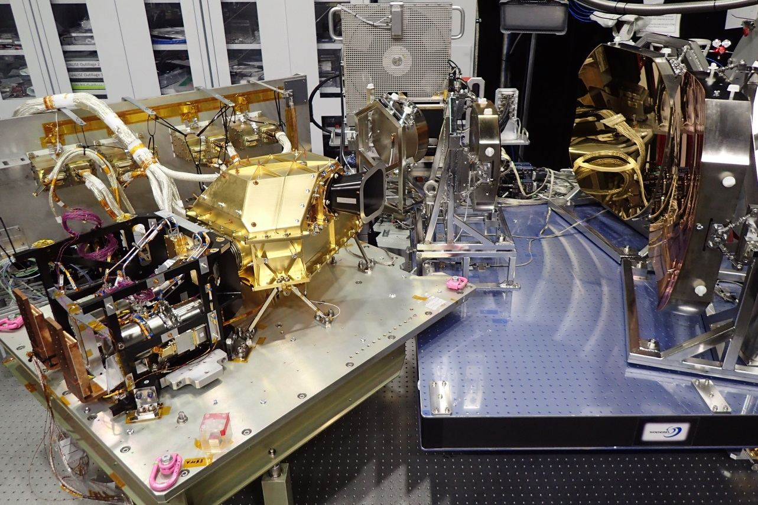
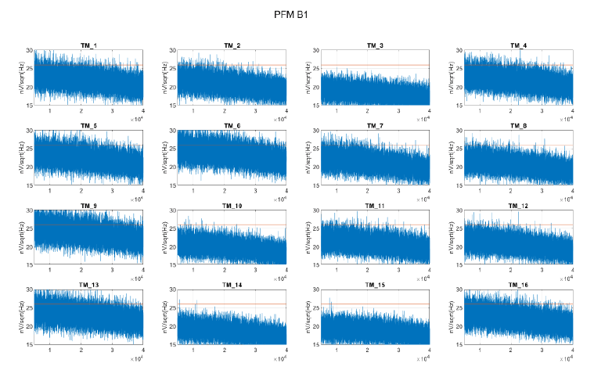
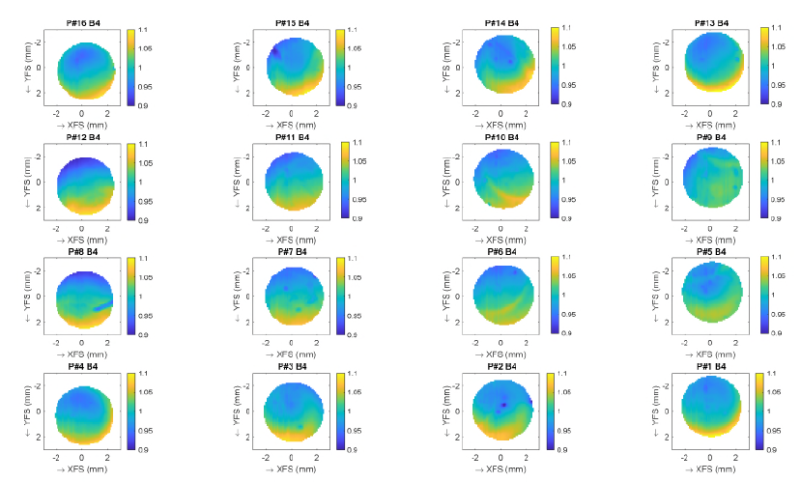
PFM SUBUNITS PERFORMANCE TESTING
FPCA
At room temperature, detectors cooled
Radiometric and geometric performances assessment in line with CDR budgets
IPSF characterization will be used for on ground processing

Slide 9
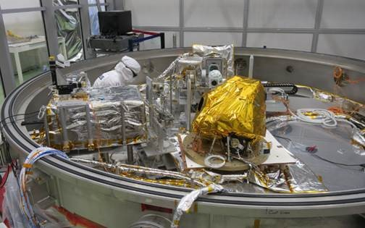
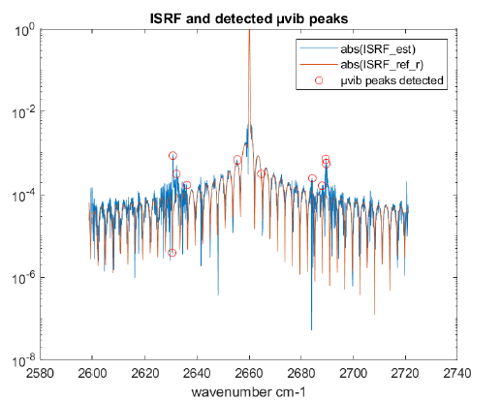
PFM SUBUNITS PERFORMANCE TESTING
IFA
IFM and metrology assembly
Spectral performance evaluation under TVAC
First spectrum acquired with gaz cell and Fabry Perot
Performances in line with CDR budgets, spectral calibration in particular with very promising results
Very good ME results
µvibration correction rate confirmed thanks to BSMA sinus mode
-1g test done to determine the BS alignment law wrt. Orientation (and in 0g)

Slide 10
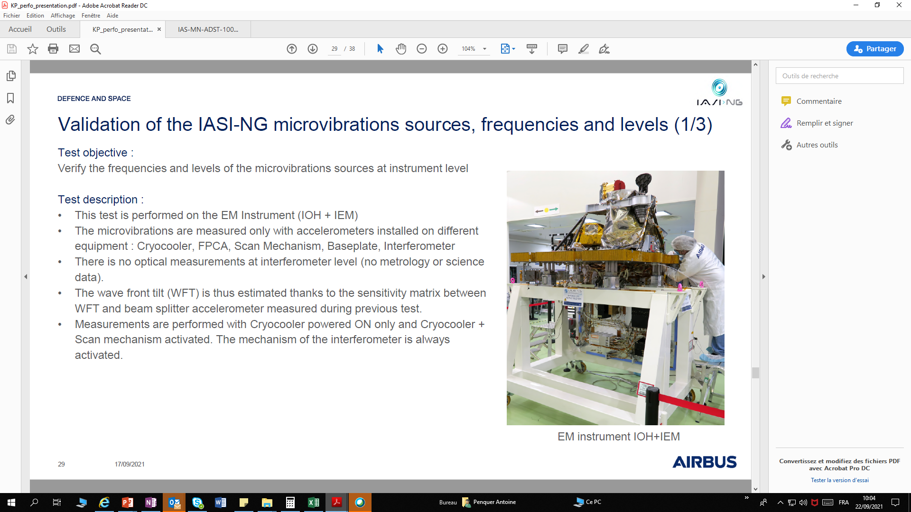

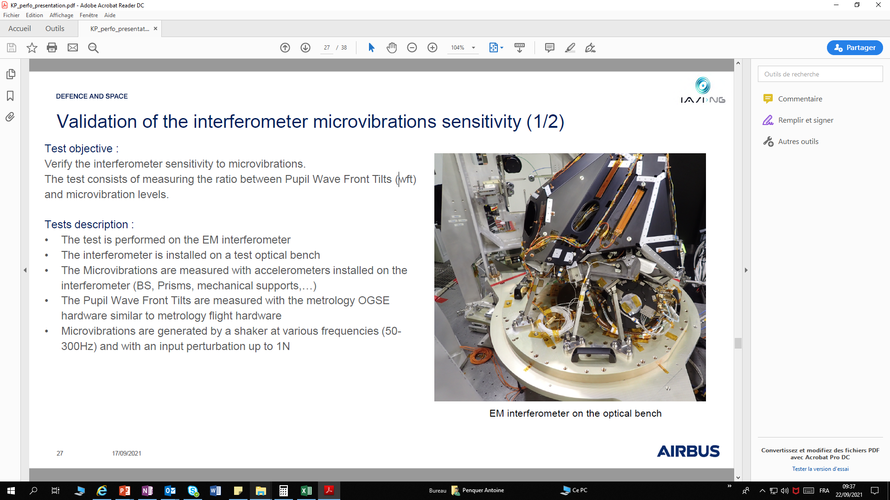
µVIBRATION CAMPAIGN
1
END-TO-END VALIDATION FOR THE INTERNAL CONTRIBUTORS
1 - Mechanical transfer function at IFM interface on EM instrument
2 - IFM sensitivity (wafe front tilt) on IFM EM
3 - Correction rate evaluation with sinus mode (IFA PFM)
INTERNAL CONTRIBUTORS BUDGET REDUCED BY A FACTOR OF 3 COMPARED TO CDR WORST CASE STATUS
Attenuated level at instrument level (MIB filtering)
IFM sensitivity increased by a factor of 2
Ground processing correction rate efficiency confirmed
2
3

Slide 11
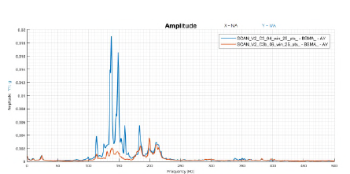
µVIBRATION CAMPAIGN
UNEXPECTED FINDING
Scan revealed as a unexpected contributor
Due to SVC control loop
Has been corrected with a new control loop law
VERY SUCCESSFUL AND USEFUL CAMPAIGN THAT CONFIRMED THE MODEL LIMITATIONS AND THE NEED TO TEST THE µVIBRATIONS

Slide 12
EM INSTRUMENT EMC CAMPAIGN AND FUNCTIONAL TESTS
EMC (CONDUCTED EMISSION) CAMPAIGN
Level as expected from subunits testing
Very small NC already presented and considered as acceptable
FUNCTIONAL TESTS AND SW CORRECTION
Procedure validation with only few limitations compared to PFM configuration
Some anomalies detected and corrected or under correction for PFM
Successful campaign securising the PFM planning
EM now delivered to SAT to validate SAT procedures
CURRENT MEASUREMENT WITH REPRESENTATIVE SAT LCL
Steady state and peak current measured in all modes

Slide 13

PFM INTEGRATION/ALIGNMENT ACTIVITIES
SUBUNITS LEVEL
FPCA and IFM integration and alignment
Telescopes alignment: done but with more iterations than expected
SUBUNITS INTEGRATION ON MIB

Slide 14
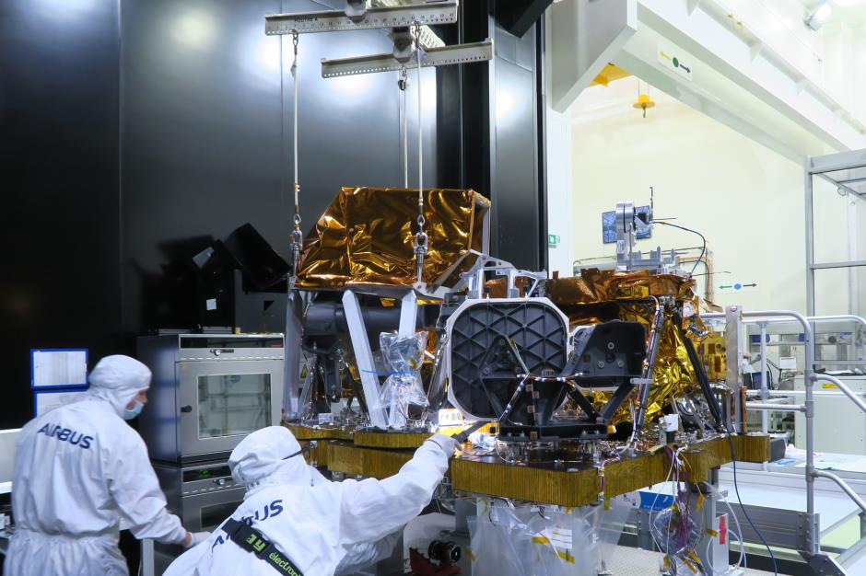
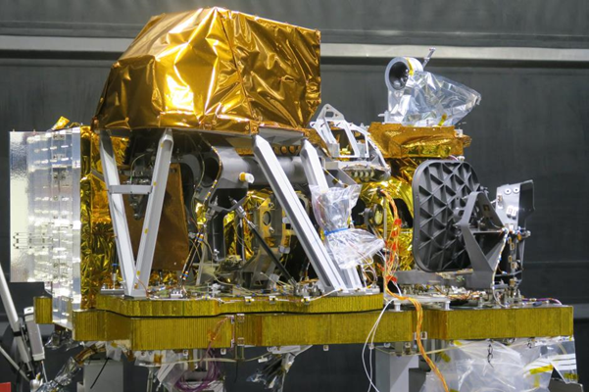
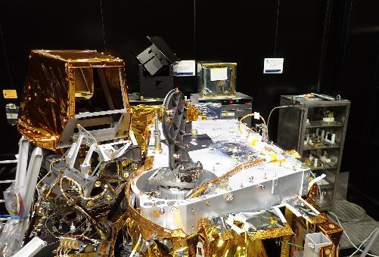
PFM INTEGRATION/ALIGNMENT ACTIVITIES
METROLOGY ALIGNMENT
Securisation activities to insure best alignment and to check the margins
Emission heads aligned after ITA integration on MIB
Reception heads aligned after ATA integration on MIB
Overall alignment is very good. Only central reception head presents low vigneting margin
Alignment will be re-assessed after mechanical test
I-OH INTEGRATION NOW COMPLETED

Slide 15
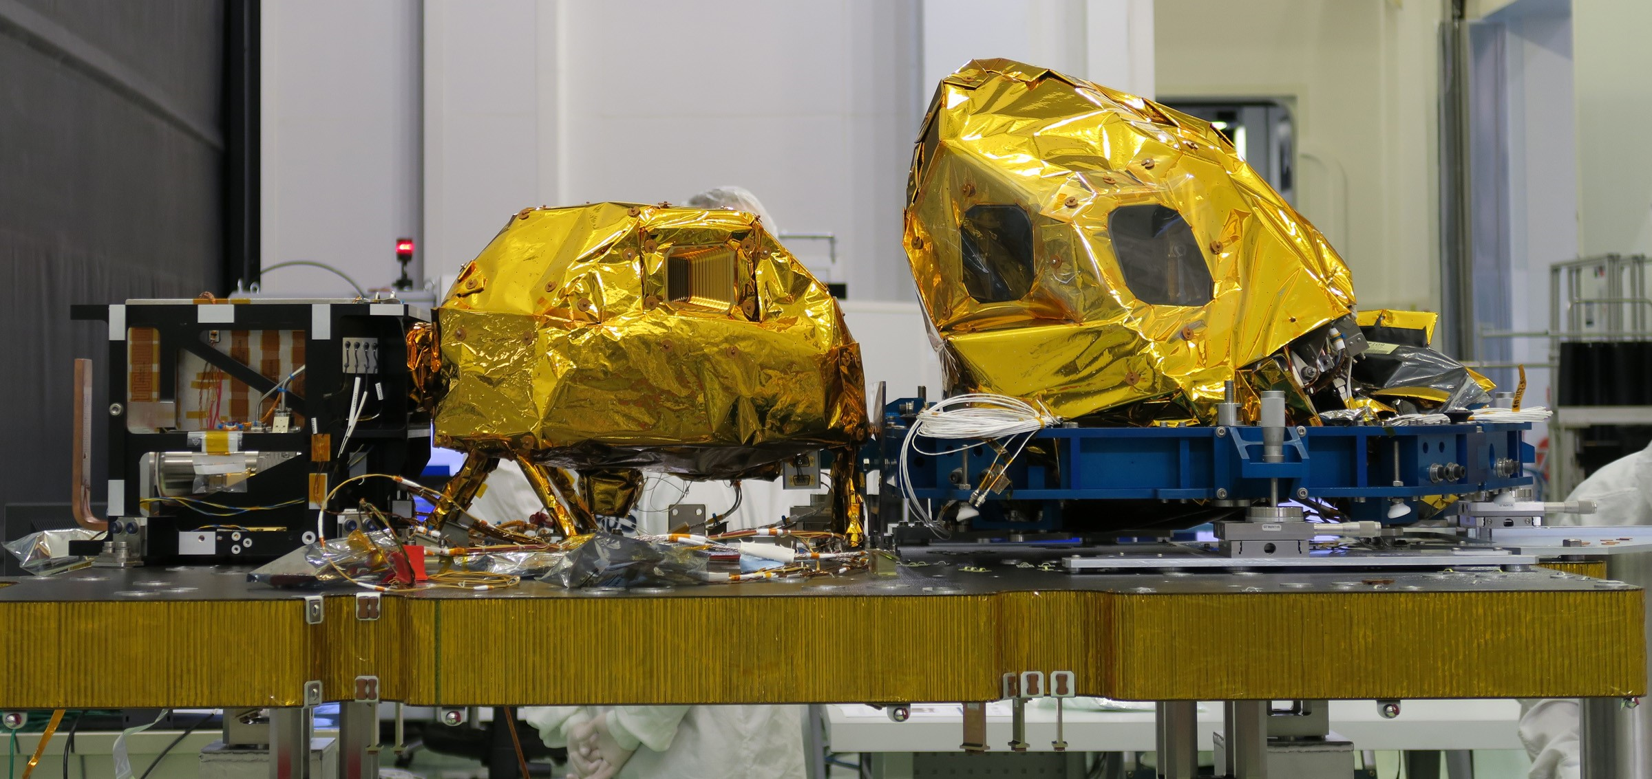
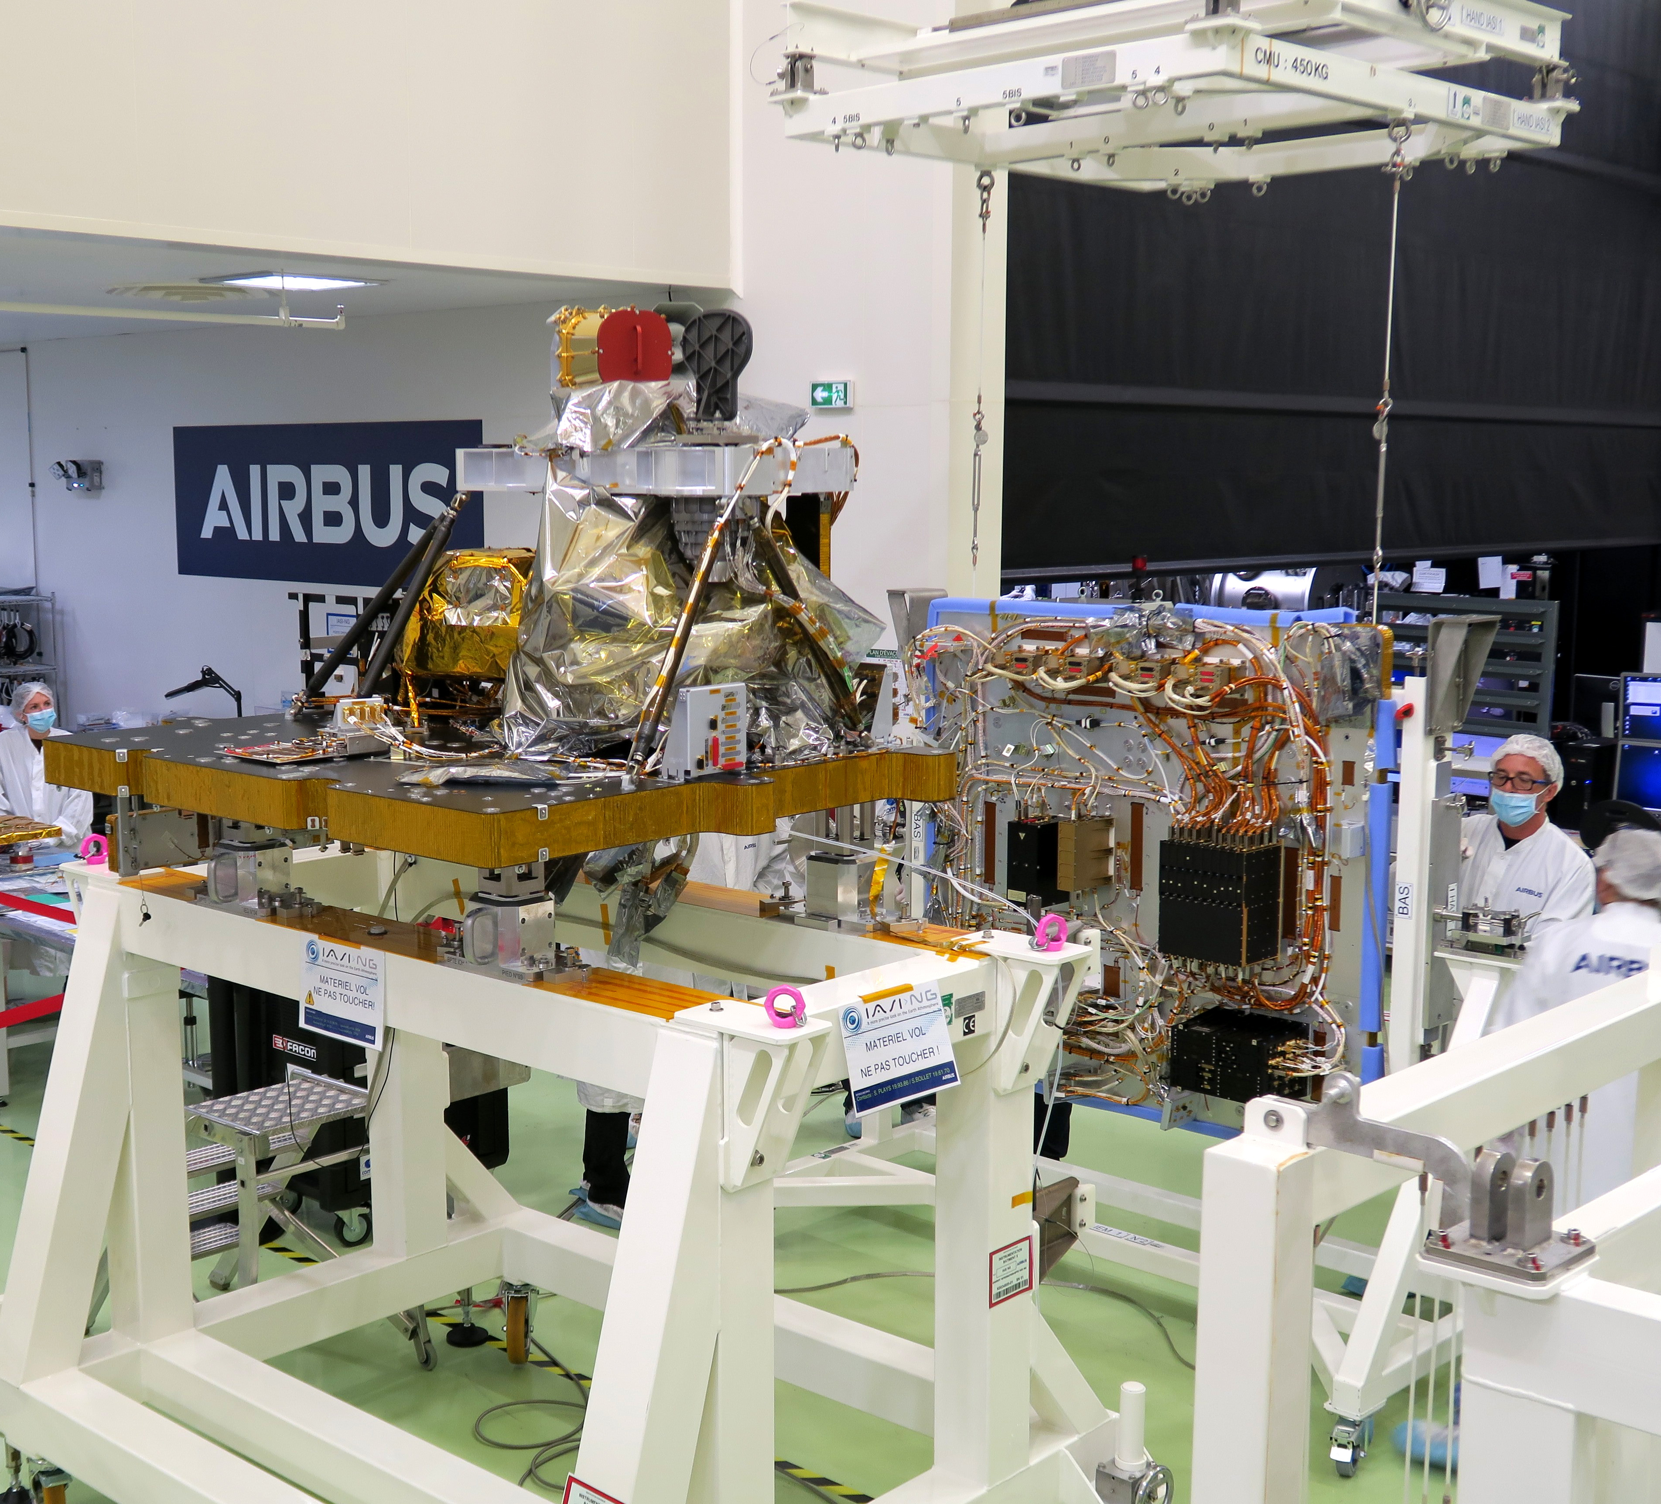
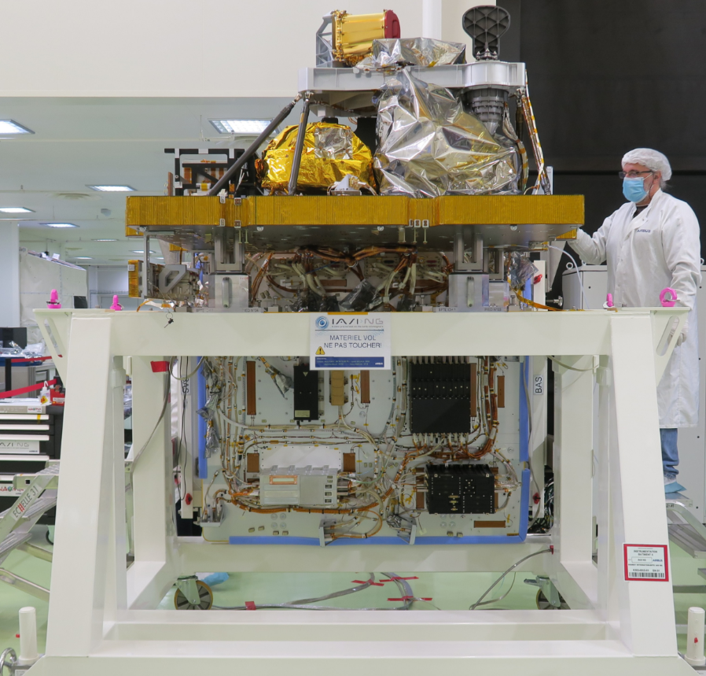
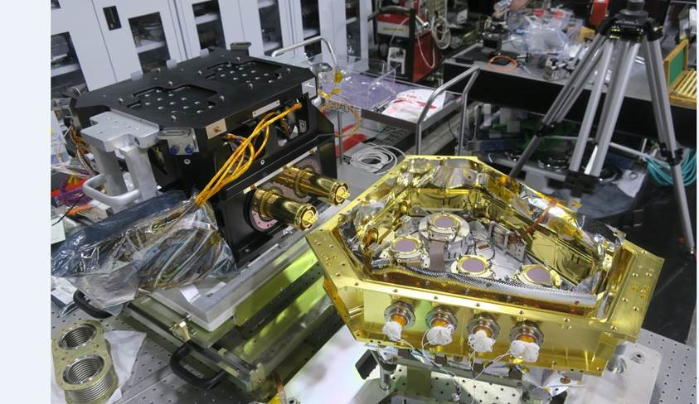
COMPLETED MILESTONES SINCE CDR AND REMAINING ACTIVITIES UNTIL DELIVERY
IFM EM MECH/THERM
EM µVIB
EM EMC (CONDUCTED)
+ FUNCTIONNAL TESTS
IFM
QUALIFIED
EM
DELIVERY
INSTRUMENT EM AIT
2020
2021
2022
Aug
Sep
Oct
Nov
Dec
Jan
Feb
Mar
Apr
May
Jun
July
Aug
Sep
Oct
Nov
Dec
Jan
Feb
Mar
Apr
May
FPCA PFM AIT & PERFORMANCE TEST
INSTRUMENT
PERFO. KP
PFM DELIVERY
IFA PFM AIT & PERFORMANCE TEST
I-OH/I-EM INTEGRATION COMPLETED
PFM I-EM INTEGRATION
MECH.
TESTS
FUNCT.
TESTS
TVAC
EMC
PFM I-OH INTEGRATION

Slide 16
THANK YOU FOR YOUR ATTENTION !

